Slide 1
2025 Montana Stockgrowers
Carcass Information

Slide 2
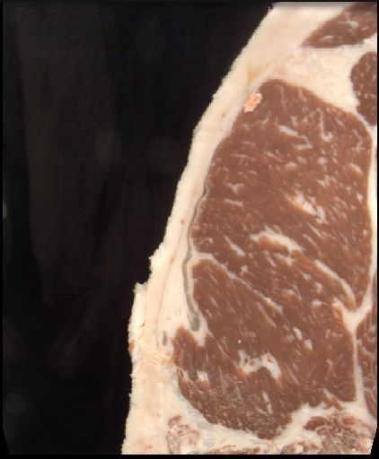
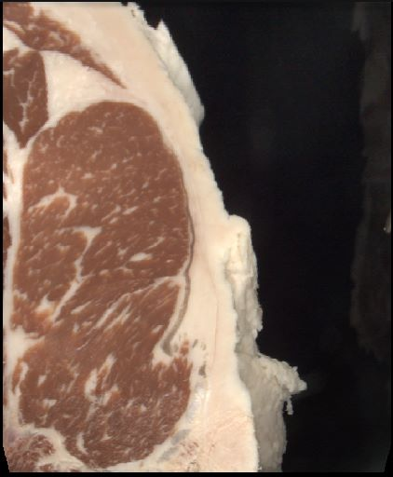
EID-840003285928343-- Tag #51
Hot Weight | Rib Eye Area | Back Fat | Yield Grade | Marbling Score | USDA Grade | G Program
879 | 12.89 | 0.46 | 3.26 | 763 | PRIME | G157

Slide 3
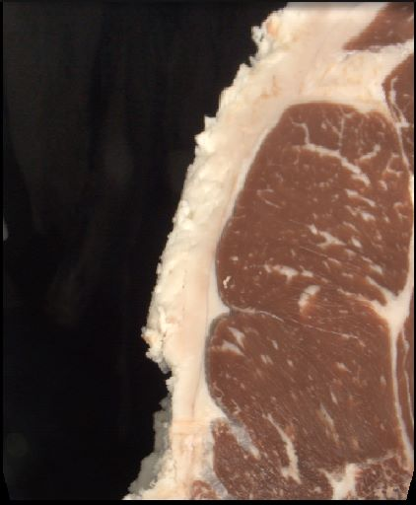
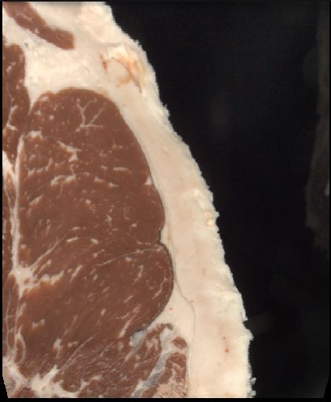
EID-840003285928332 – Tag # 83
Hot Weight | Rib Eye Area | Back Fat | Yield Grade | Marbling Score | USDA Grade | G Program
946 | 13.13 | 0.73 | 4.06 | 592 | CHOICE | None

Slide 4
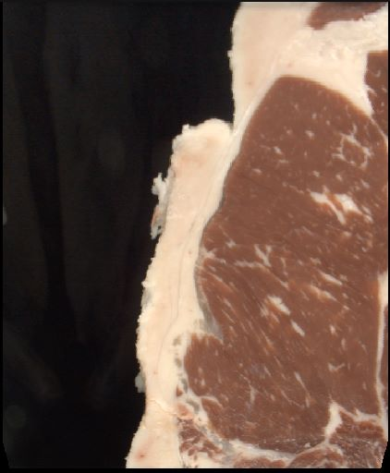
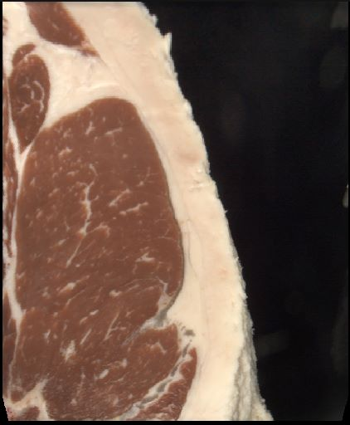
EID-840003285930436 – Tag # 19
Hot Weight | Rib Eye Area | Back Fat | Yield Grade | Marbling Score | USDA Grade | G Program
881 | 13.63 | 0.67 | 3.52 | 516 | CHOICE | G154

Slide 5
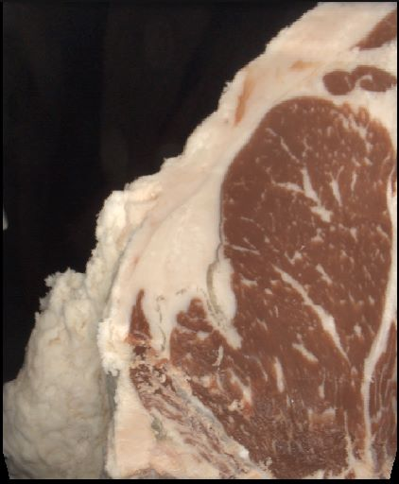
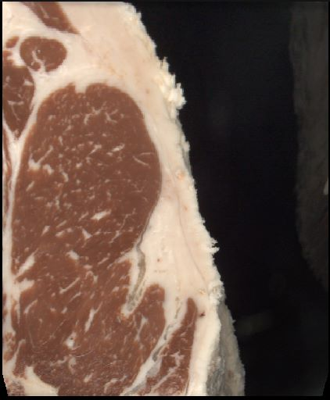
EID-840003285928385 – Tag # 33
Hot Weight | Rib Eye Area | Back Fat | Yield Grade | Marbling Score | USDA Grade | G Program
943 | 12.24 | 0.64 | 4.23 | 705 | CHOICE | G157

Slide 6
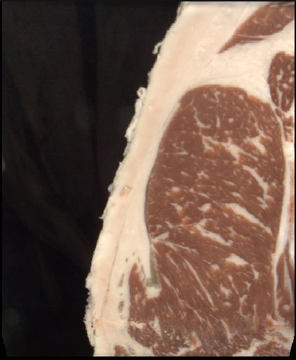
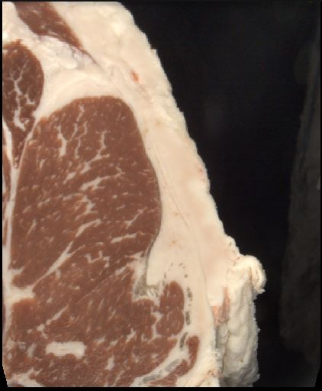
EID-840003285928336 – Tag # 43
Hot Weight | Rib Eye Area | Back Fat | Yield Grade | Marbling Score | USDA Grade | G Program
944 | 13.29 | 0.74 | 4.08 | 837 | PRIME | G157

Slide 7
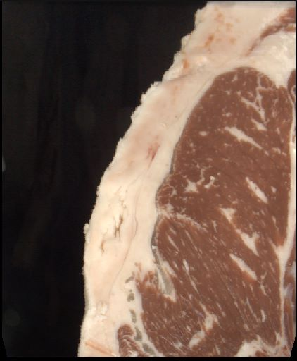
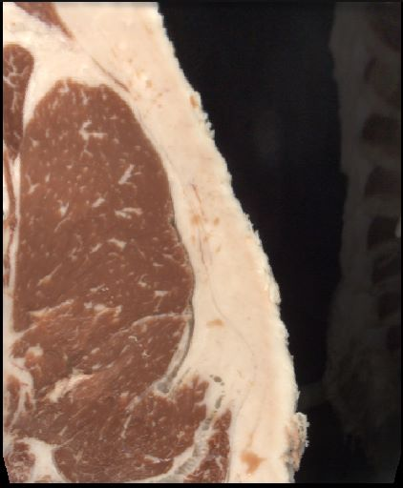
EID- 840003285928113 – Tag # 11
Hot Weight | Rib Eye Area | Back Fat | Yield Grade | Marbling Score | USDA Grade | G Program
938 | 12.62 | 0.91 | 4.83 | 703 | CHOICE | G157

Slide 8
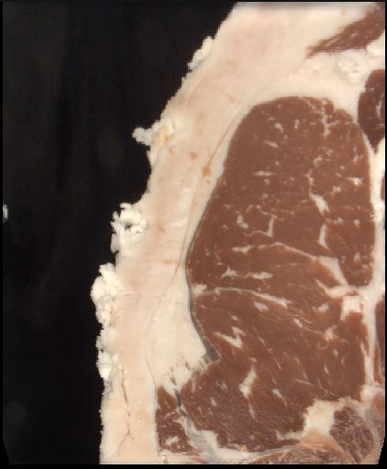
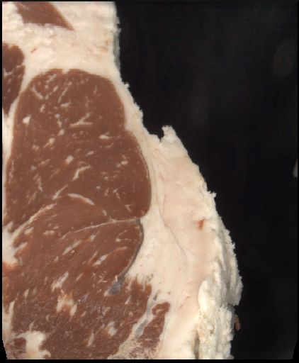
EID-840003285928935 – Tag # 66
Hot Weight | Rib Eye Area | Back Fat | Yield Grade | Marbling Score | USDA Grade | G Program
998 | 13.28 | 0.65 | 4.11 | 597 | CHOICE | G154

Slide 9
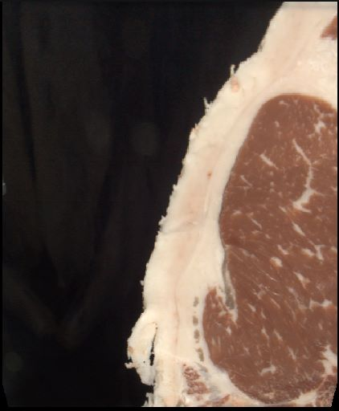
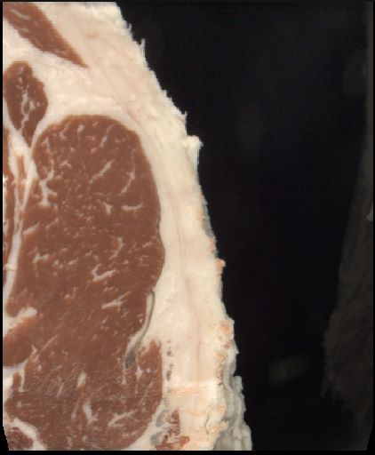
EID- 840003285928960 – Tag # 80
Hot Weight | Rib Eye Area | Back Fat | Yield Grade | Marbling Score | USDA Grade | G Program
820 | 10.25 | 0.75 | 4.65 | 557 | CHOICE | None

Slide 10
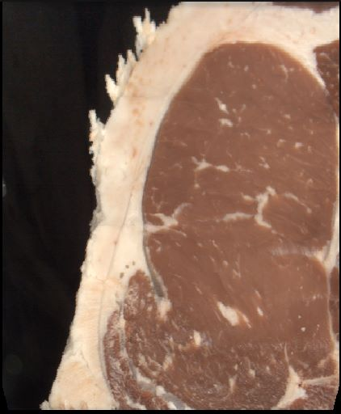
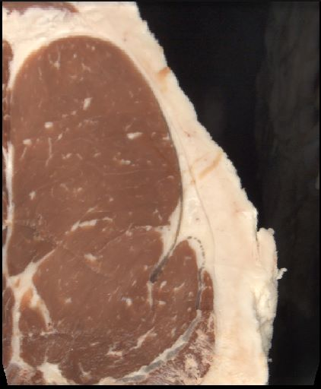
EID-840003285928322 – Tag # 52
Hot Weight | Rib Eye Area | Back Fat | Yield Grade | Marbling Score | USDA Grade | G Program
981 | 17.77 | 0.65 | 2.85 | 399 | SELECT | None

Slide 11
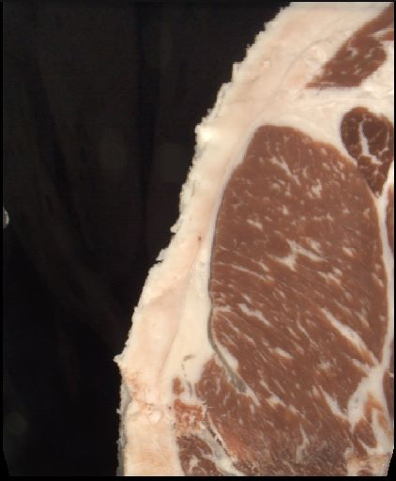
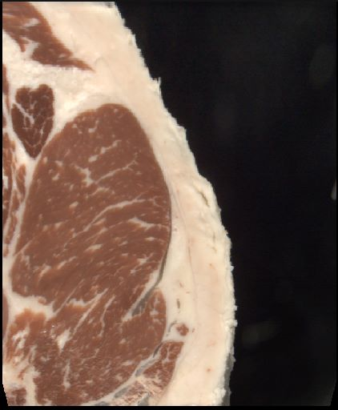
EID-840003288019088 – Tag # 79
Hot Weight | Rib Eye Area | Back Fat | Yield Grade | Marbling Score | USDA Grade | G Program
778 | 11.69 | 0.69 | 3.94 | 767 | PRIME | G157

Slide 12
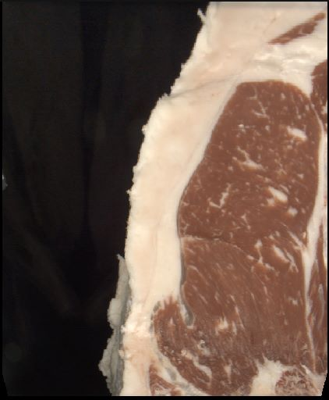
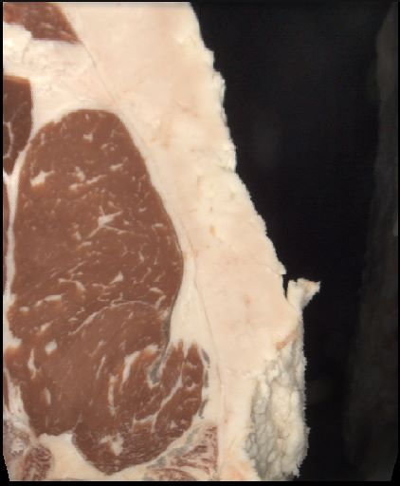
EID-840003285928230 – Tag # 25
Hot Weight | Rib Eye Area | Back Fat | Yield Grade | Marbling Score | USDA Grade | G Program
854 | 11.74 | 0.87 | 4.55 | 622 | CHOICE | G154

Slide 13
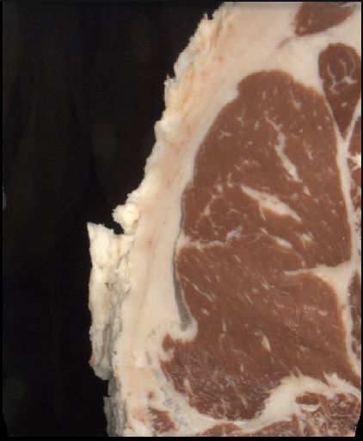
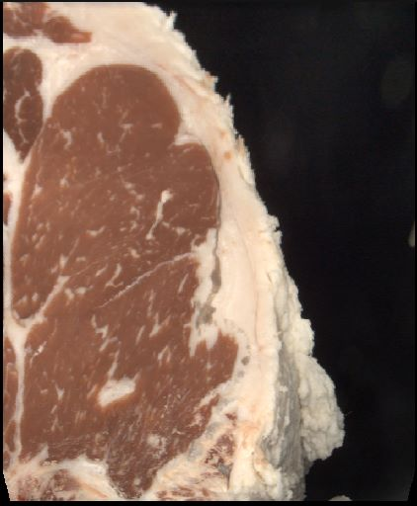
EID-840003285928300 – Tag # 92
Hot Weight | Rib Eye Area | Back Fat | Yield Grade | Marbling Score | USDA Grade | G Program
980 | 13.61 | 0.65 | 3.9 | 556 | CHOICE | G154

Slide 14
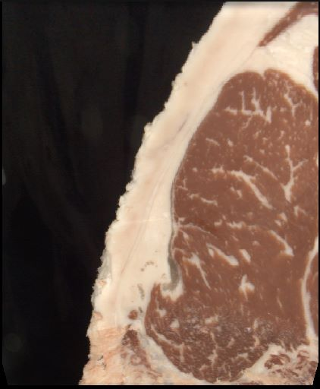
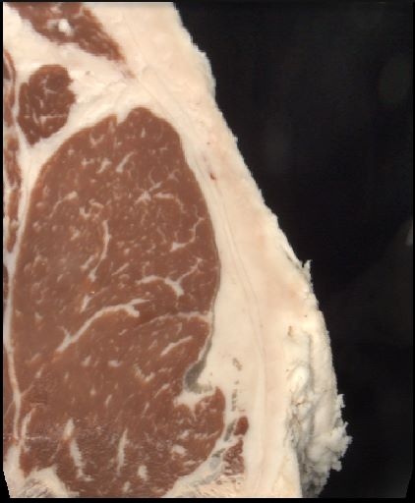
EID-840003285928318 – Tag # 44
Hot Weight | Rib Eye Area | Back Fat | Yield Grade | Marbling Score | USDA Grade | G Program
924 | 13.43 | 0.81 | 4.13 | 751 | PRIME | G157

Slide 15
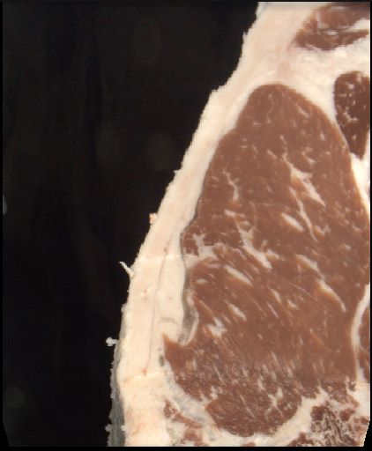
EID-840003285930477 – Tag # 3
Hot Weight | Rib Eye Area | Back Fat | Yield Grade | Marbling Score | USDA Grade | G Program
837 | 13.12 | 0 | 3.17 | 600 | CHOICE | G154

Slide 16
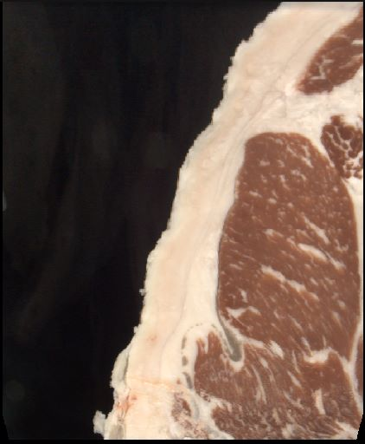
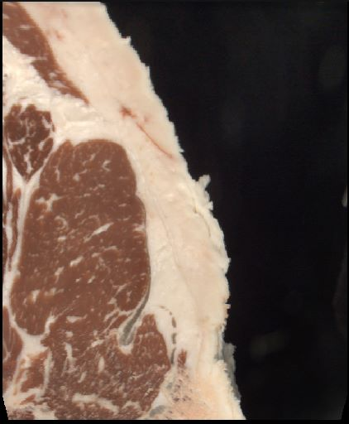
EID-840003282577074 -- Tag # 58
Hot Weight | Rib Eye Area | Back Fat | Yield Grade | Marbling Score | USDA Grade | G Program
712 | 10.01 | 0.88 | 4.68 | 763 | PRIME | G64

Slide 17
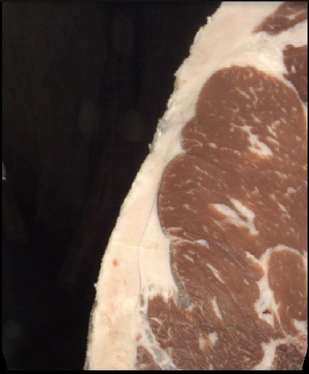
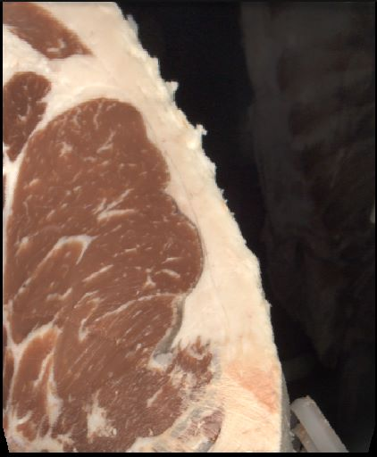
EID-840003285928260 – Tag # 28
Hot Weight | Rib Eye Area | Back Fat | Yield Grade | Marbling Score | USDA Grade | G Program
929 | 13.27 | 0.56 | 3.6 | 587 | CHOICE | G154

Slide 18
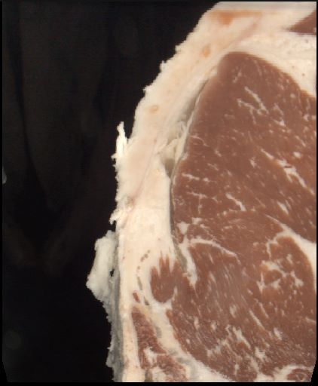
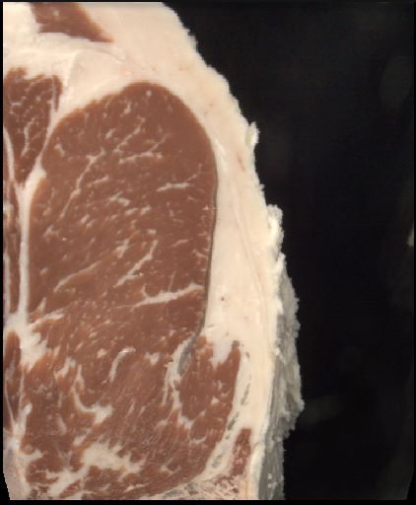
EID-840003285928140 – Tag # 8
Hot Weight | Rib Eye Area | Back Fat | Yield Grade | Marbling Score | USDA Grade | G Program
897 | 13.77 | 0.65 | 3.67 | 720 | PRIME | G157

Slide 19
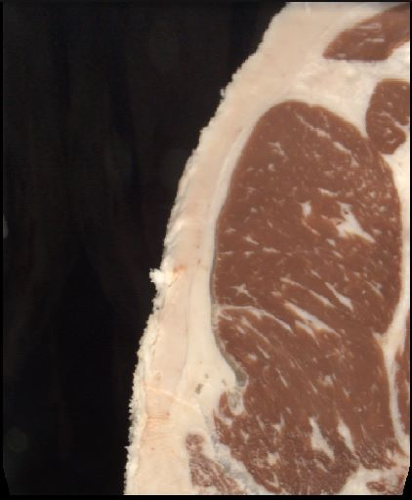
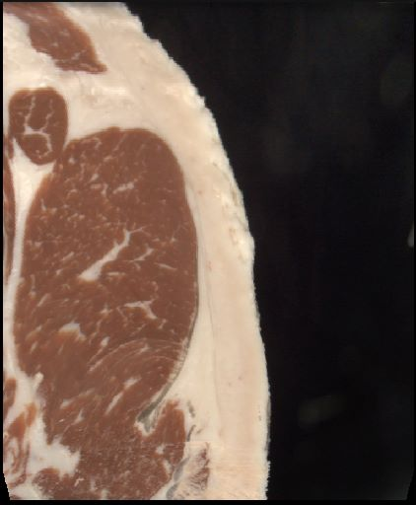
EID- 840003285928126 – Tag # 21
Hot Weight | Rib Eye Area | Back Fat | Yield Grade | Marbling Score | USDA Grade | G Program
846 | 12.37 | 0.73 | 4.01 | 660 | CHOICE | G154

Slide 20
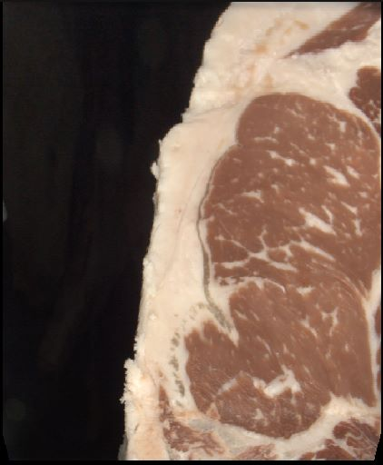
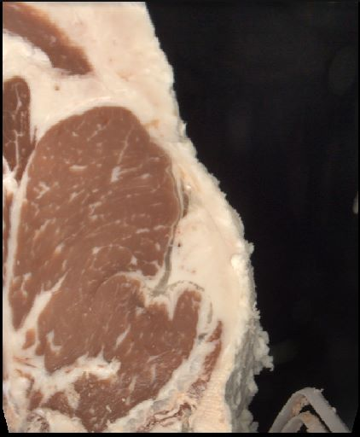
EID-840003285928136 – Tag # 4
Hot Weight | Rib Eye Area | Back Fat | Yield Grade | Marbling Score | USDA Grade | G Program
922 | 12.42 | 0.62 | 4.35 | 662 | CHOICE | G154

Slide 21
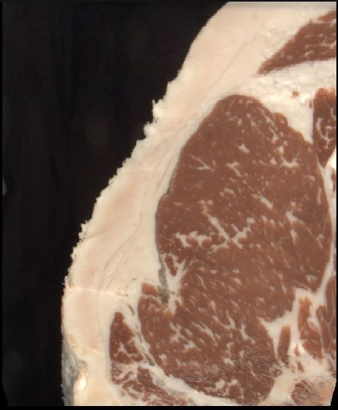
EID- 840003285928315 – Tag # 57
Hot Weight | Rib Eye Area | Back Fat | Yield Grade | Marbling Score | USDA Grade | G Program
787 | 12.99 | 0 | 4.01 | 767 | PRIME | G157

Slide 22
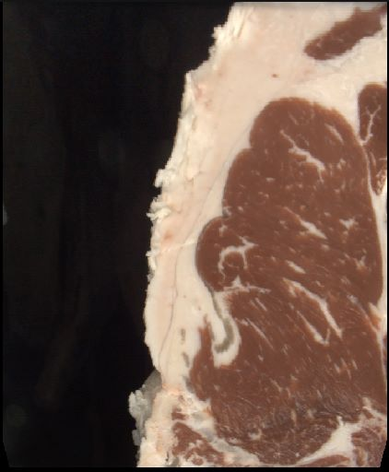
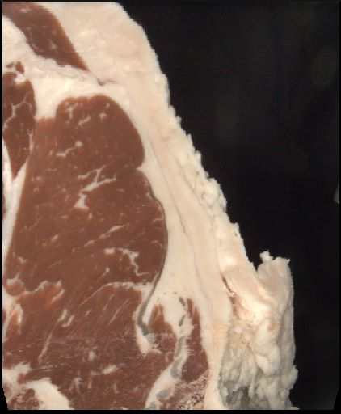
EID-840003285928179 – Tag # 39
Hot Weight | Rib Eye Area | Back Fat | Yield Grade | Marbling Score | USDA Grade | G Program
954 | 12.69 | 0.8 | 4.44 | 510 | CHOICE | None

Slide 23
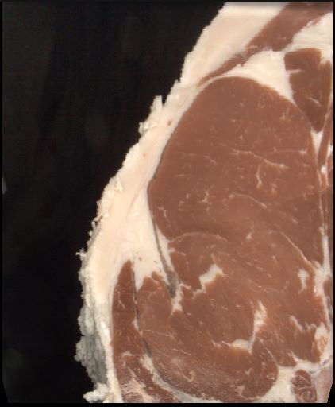
EID-840003285928237 – Tag # 31
Hot Weight | Rib Eye Area | Back Fat | Yield Grade | Marbling Score | USDA Grade | G Program
898 | 16 | 0 | 2.44 | 350 | SELECT | None

Slide 24
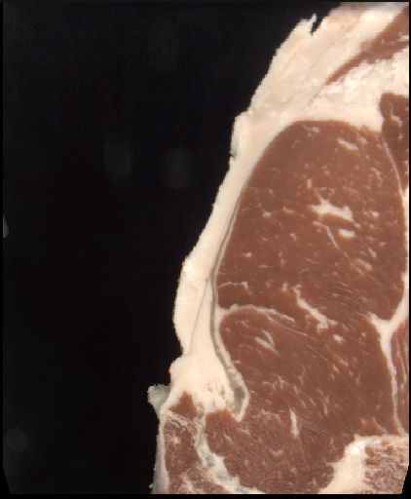
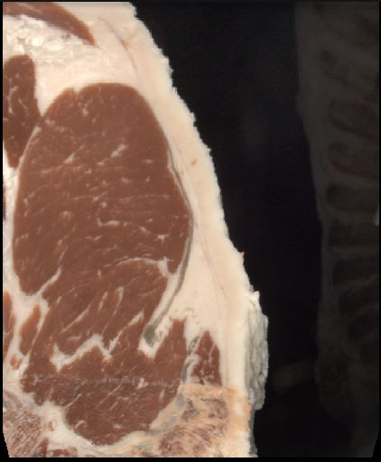
EID-840003285928778 – Tag # 85
Hot Weight | Rib Eye Area | Back Fat | Yield Grade | Marbling Score | USDA Grade | G Program
792 | 12.41 | 0.41 | 2.95 | 475 | CHOICE | G154

Slide 25
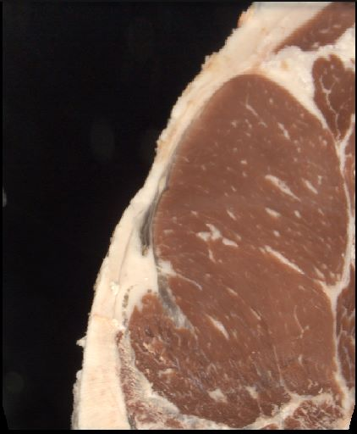
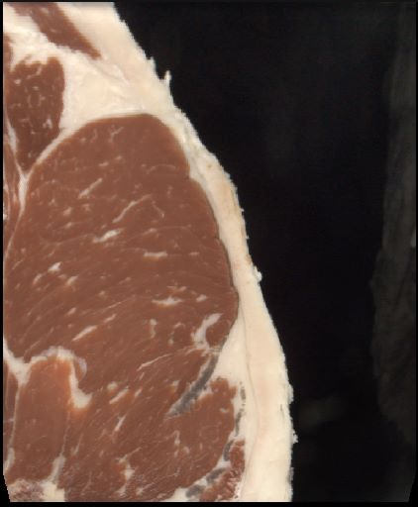
EID-840003285928117 – Tag # 23
Hot Weight | Rib Eye Area | Back Fat | Yield Grade | Marbling Score | USDA Grade | G Program
957 | 15.98 | 0.42 | 2.44 | 454 | CHOICE | G154

Slide 26
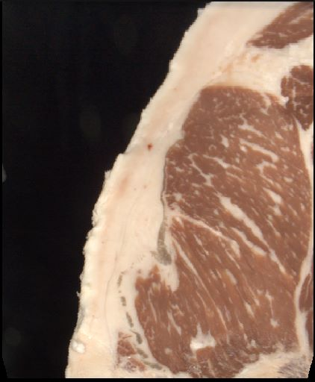
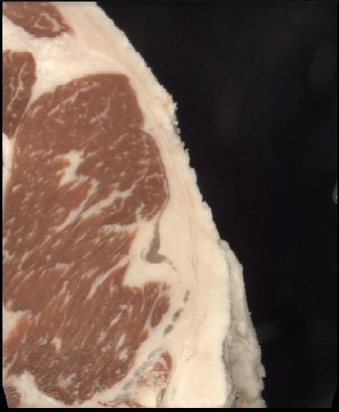
EID-840003285928133 – Tag # 22
Hot Weight | Rib Eye Area | Back Fat | Yield Grade | Marbling Score | USDA Grade | G Program
875 | 12.49 | 0.63 | 4.03 | 815 | PRIME | G157

Slide 27
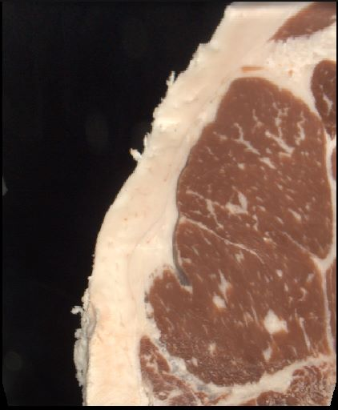
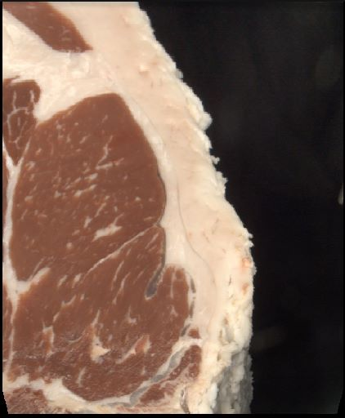
EID-840003285928141 -- Tag # 16
Hot Weight | Rib Eye Area | Back Fat | Yield Grade | Marbling Score | USDA Grade | G Program
888 | 12.93 | 0.87 | 4.34 | 661 | CHOICE | G64

Slide 28
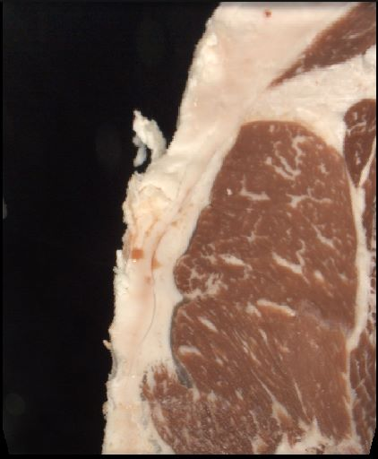

EID-840003285928337 – Tag # 47
Hot Weight | Rib Eye Area | Back Fat | Yield Grade | Marbling Score | USDA Grade | G Program
1074 | 13.55 | 1 | 5.24 | 779 | PRIME | G157

Slide 29


EID-840003285928101 – Tag # 12
Hot Weight | Rib Eye Area | Back Fat | Yield Grade | Marbling Score | USDA Grade | G Program
910 | 14.36 | 0.59 | 3.29 | 567 | CHOICE | G154

Slide 30


EID-840003293500960 – Tag # 84
Hot Weight | Rib Eye Area | Back Fat | Yield Grade | Marbling Score | USDA Grade | G Program
963 | 15.06 | 0.54 | 3.11 | 704 | PRIME | G157

Slide 31

EID-840003285928635 – Tag # 82
Hot Weight | Rib Eye Area | Back Fat | Yield Grade | Marbling Score | USDA Grade | G Program
923 | 14.4 | 0 | 3.21 | 439 | CHOICE | None

Slide 32


EID-840003285928630 – Tag # 86
Hot Weight | Rib Eye Area | Back Fat | Yield Grade | Marbling Score | USDA Grade | G Program
1004 | 13.85 | 0.52 | 3.58 | 678 | CHOICE | G64

Slide 33


EID-840003285930336 – Tag # 87
Hot Weight | Rib Eye Area | Back Fat | Yield Grade | Marbling Score | USDA Grade | G Program
984 | 13.79 | 0.56 | 3.6 | 657 | CHOICE | G154

Slide 34


EID-840003285928359 – Tag # 34
Hot Weight | Rib Eye Area | Back Fat | Yield Grade | Marbling Score | USDA Grade | G Program
1004 | 13.38 | 0.77 | 4.34 | 492 | CHOICE | G154

Slide 35


EID-840003286885367 – Tag # 61
Hot Weight | Rib Eye Area | Back Fat | Yield Grade | Marbling Score | USDA Grade | G Program
921 | 12.44 | 0.77 | 4.79 | 667 | CHOICE | G154

Slide 36


EID-840003285930535 -- Tag # 62
Hot Weight | Rib Eye Area | Back Fat | Yield Grade | Marbling Score | USDA Grade | G Program
876 | 12.23 | 0.68 | 4.01 | 678 | CHOICE | G154

Slide 37


EID-840003290917849 – Tag # 75
Hot Weight | Rib Eye Area | Back Fat | Yield Grade | Marbling Score | USDA Grade | G Program
920 | 12.45 | 0.66 | 4 | 725 | PRIME | G157

Slide 38


EID-840003285930543 – Tag # 59
Hot Weight | Rib Eye Area | Back Fat | Yield Grade | Marbling Score | USDA Grade | G Program
954 | 12.85 | 0.82 | 4.43 | 714 | CHOICE | G157

